Slide 1
D-AMCVIS: Tactical Vehicle Communication
Advanced, Multi-Crew Vehicle Intercom Systems
Secure Multichannel Communication for Extreme Environments
Designed, manufactured in the USA

Slide 2
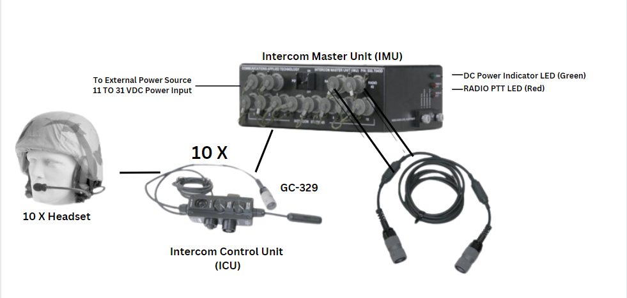
The Digital Advanced Multichannel Vehicle Intercom System (D-AMCVIS)
is the trusted communication solution for military, security, and tactical vehicles.
Designed for resilience, flexibility, and adaptability,
it provides unmatched reliability in mission-critical operations.
Designed and Manufactured in the USA

Slide 3
Digital Controlled ICU

Slide 4
Key Features
- Independent Radio and Intercom Control
- Personal Volume Controls
- Intra-team and radio communications
- Compact, User-Friendly Design
- Seamless Compatibility with Commercial and Military Radios
- Rugged Durability and Rapid Deployment

Slide 5
System Components
- Intercom Master Unit (IMU): Links crew members and radios.
Intercom Control Unit (ICU): Intuitive controls for listening levels and P-T-T.
Optional Add-Ons:
Advanced Noise Reduction Headsets
Radio Bridging Circuit.

Slide 6
Low Profile, 5-Crewman Configuration
- Includes IMU and five ICUs.
- Seamless radio interoperability without requiring a computer.
- Robust radio interface cables for commercial and military radios.

Slide 7
Operational Benefits
- Resilience and Flexibility: Uninterrupted communication in extreme environments.
- Ease of Use: Minimal training required for operation.
- Cost-Effective Solution: Advanced functionality at a fraction of the cost.

Slide 8
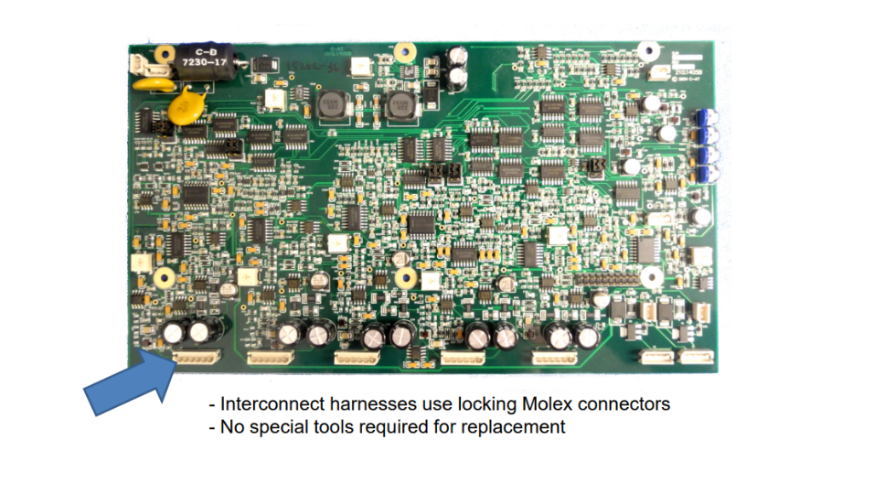
Field Repairable

Slide 9
Mounting Options

Slide 10
AMCVIS w/ICRI = Compatibility
Radio Agnostic
Integrates public safety/military radios, satellite devices, encrypted systems, and cell networks. Supports Project 25 (P25) standards and connects IP-based MANET radios with traditional systems.

Slide 11
ICRI
Incident Commanders Radio Interface

Slide 12
Proven in the Field
“Our military ground unit deployed to an Arctic region for training. Despite the freezing temperatures, the D-AMCVIS provided reliable communication between the crew and the command center. Its performance was exceptional.”
— USASOC, Ft. Bragg

Slide 13
Contact Us
For more information or to discuss your tactical communication needs:
Perry Sandy
Communications-Applied Technology
+1-703-481-0068
Website: https://www.c-at.com
Company Details: CAGE Code: 0EEY2 SIC Code: 3669
TIN: 54-1215868 DUNS: 08‐104‐0214
Business Classification: Small Business, Veteran-Owned Small Business (DOL-certified), Disabled Veteran Owned Small Business

